Slide 1
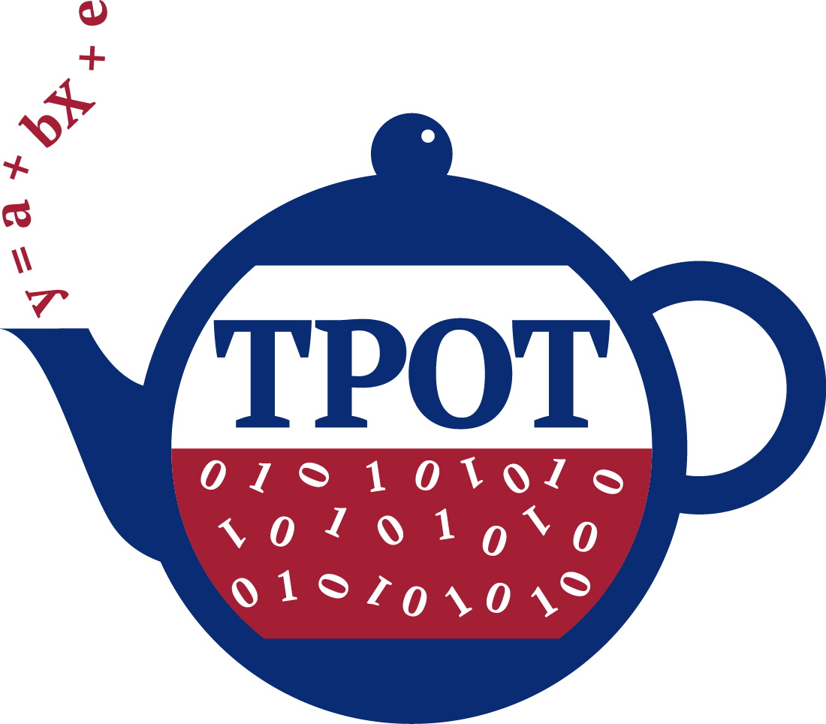





Automated Machine Learning through Tree-based Pipeline Optimization
Dr. Randy Olson
rso@randalolson.com
@randal_olson
randalolson.com

Slide 2
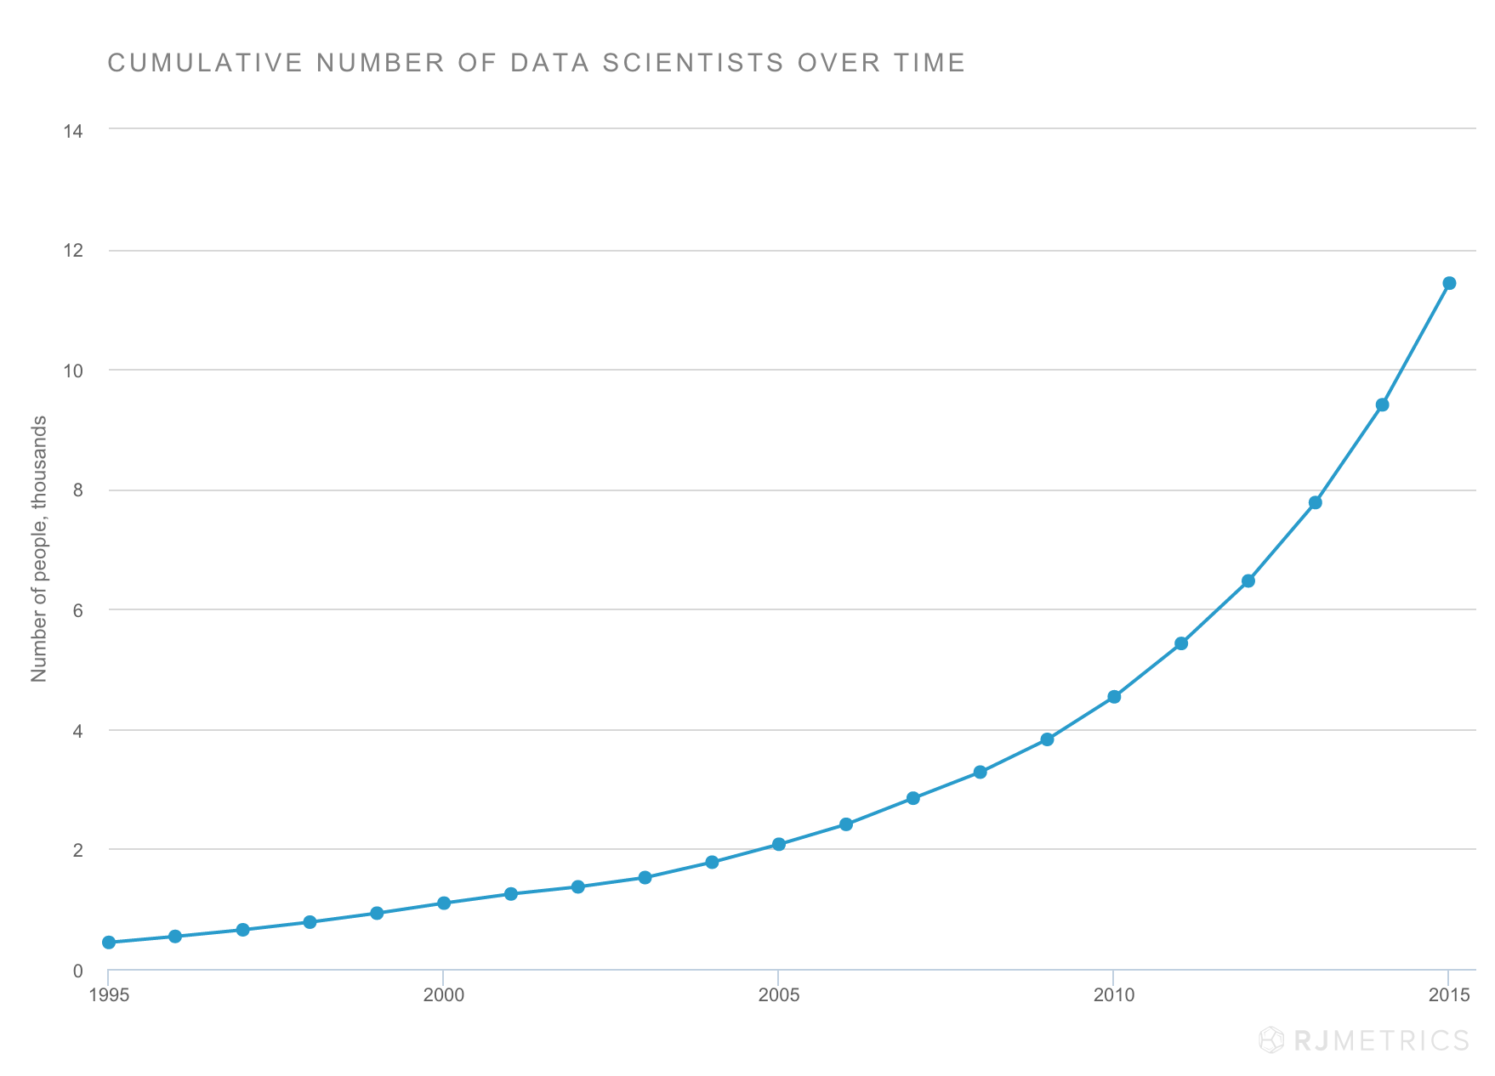
Source: rjmetrics.com/resources/reports/the-state-of-data-science/
Notes:
Number of self-reported data scientists has doubled in the past 5 years.
As data science and ML come to the forefront of academia, business, and government, we will need more tools that make ML more accessible, scalable, and flexible.

Slide 3
Machine Learning: “A field of study that gives computers the ability to learn without being explicitly programmed.”

Slide 4
Notes:
All of this points to one conclusion…

Slide 5
Machine learning can be tedious
Notes:
Machine learning can be tedious because it takes a lot of manual tuning.

Slide 6
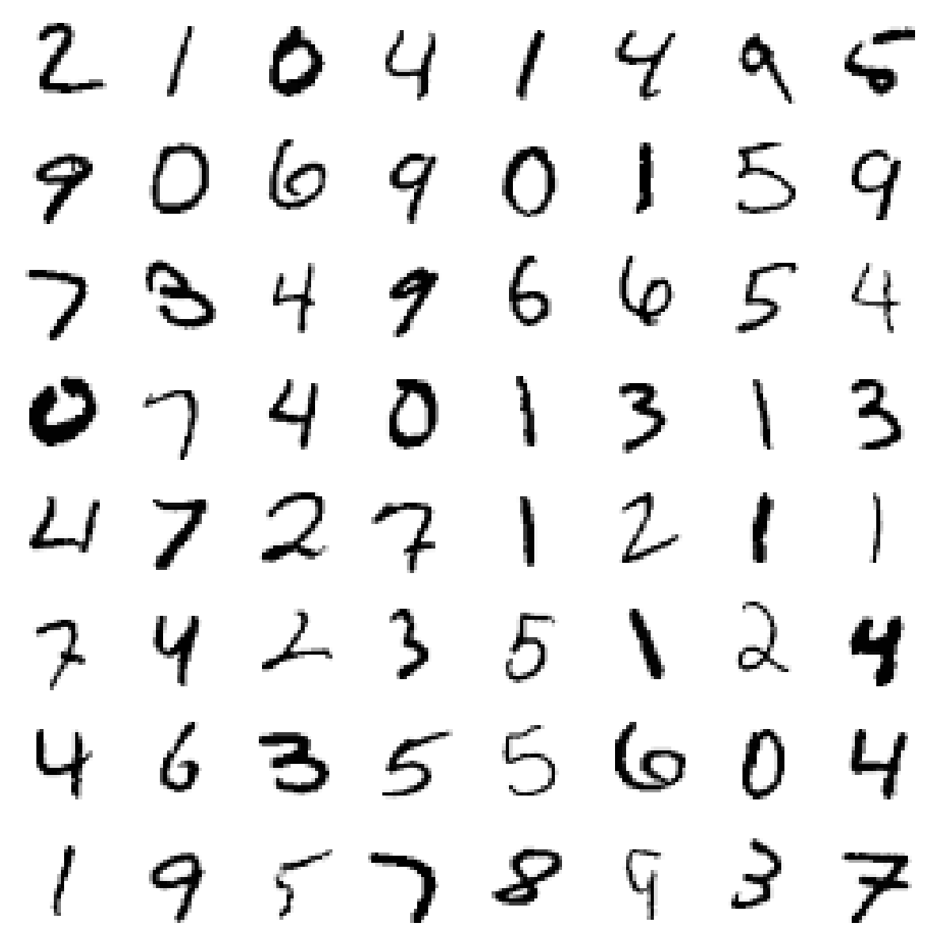
Can a Random Forest classify it?
Yes!
Random Forest (10 trees): 94% accuracy
Random Forest (1,000 trees): 97% accuracy
3% of 1,000,000 = 30k misclassified numbers

Slide 7
Parameter tuning is important

Slide 8
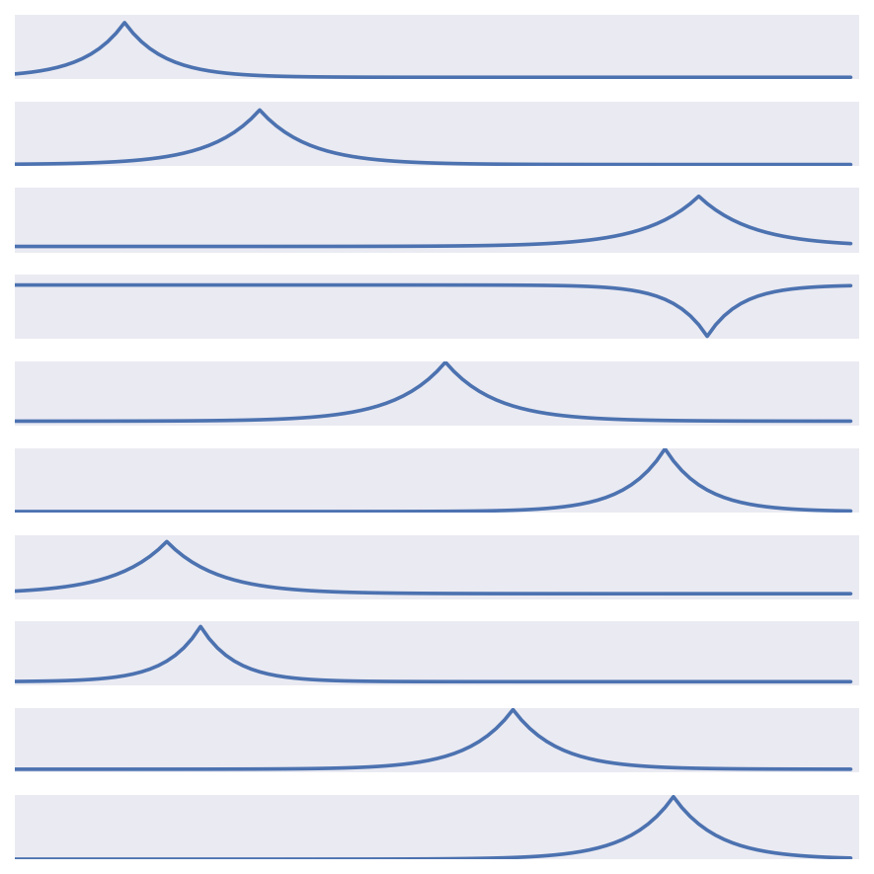
Can a Random Forest classify it?
Nope.
61.8% accuracy
Logistic Regression: 99.7% accuracy
Notes:
Decompose the data with PCA

Slide 9
Model selection is important
Notes:
“Junk in, junk out” is a popular expression in machine learning for a reason.

Slide 10
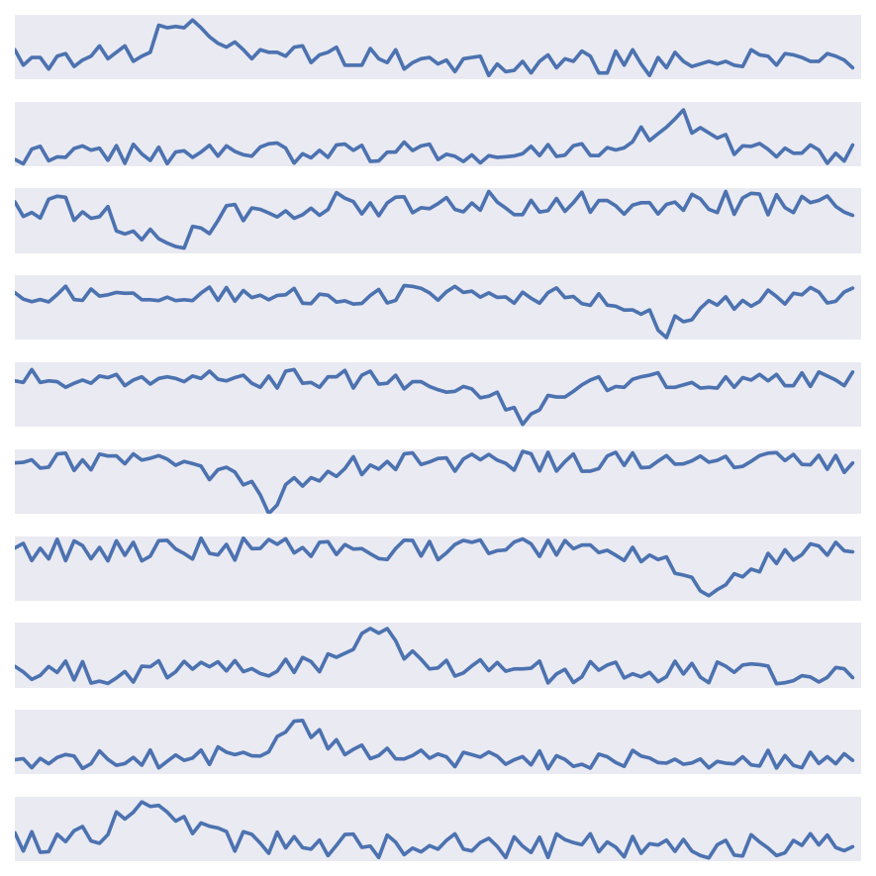
Can a Random Forest classify it?
Nope.
58% accuracy
Decompose w/ PCA: 94% accuracy
Notes:
Decompose the data with PCA

Slide 11
Feature preprocessing is important

Slide 12
Recap
We should:
Always tune the hyperparameters for our models
Always try out many different models
Always explore numerous feature representations for our data
However…
There are thousands of possible hyperparameter configurations for every model
There are dozens of popular machine learning models
There are dozens of popular feature preprocessing methods
Notes:
This really defeats the intended purpose of machine learning, since the idea is that the machine can learn to detect the signal in the data without human intervention.

Slide 13
Machine learning can be tedious
Notes:
Machine learning can be tedious because it takes a lot of manual tuning.

Slide 14

Source: SethBling, “MarI/O - Machine Learning for Video Games.” youtube.com/watch?v=iakFfOmanJU
Notes:
In the past decade, we’ve seen incredible advances in intelligent systems for automating difficult tasks.

Slide 15
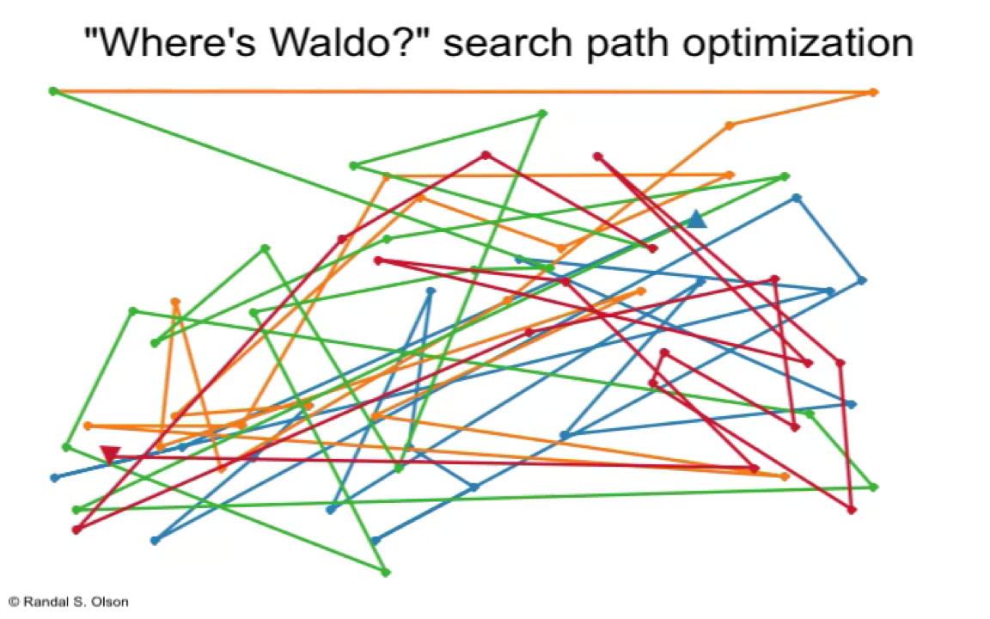
Source: randalolson.com/2015/02/03/heres-waldo-computing-the-optimal-search-strategy-for-finding-waldo/

Slide 16
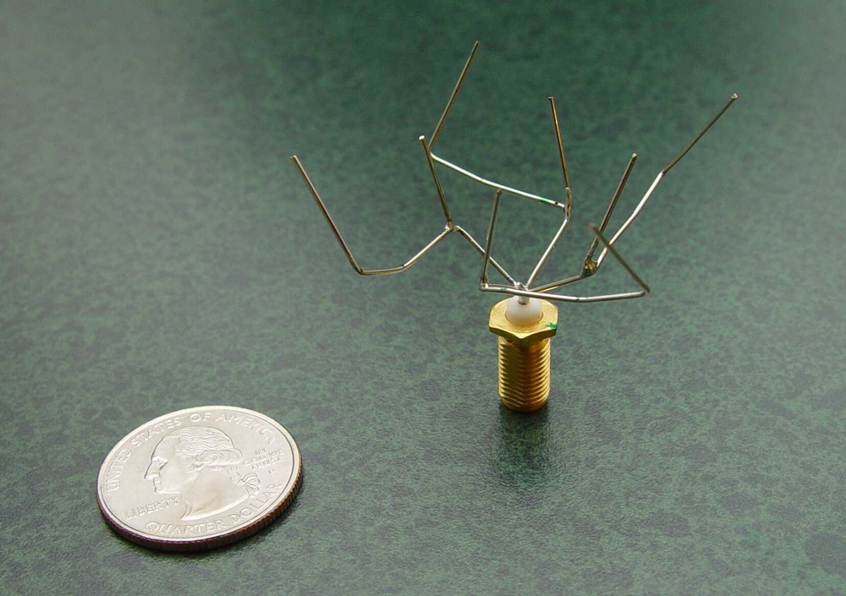
Source: G. Hornby et al. (2006), “Automated antenna design with evolutionary algorithms”
Notes:
An example of an evolved antenna is an X-band antenna evolved for a 2006 NASA mission called Space Technology 5 (ST5). The mission consists of three satellites that will take measurements in Earth's magnetosphere. Each satellite has two communication antennas to talk to ground stations. The antenna has an unusual structure and was evolved to meet a challenging set of mission requirements, notably the combination of wide beamwidth for a circularly polarized wave and wide impedance bandwidth. For comparison, a traditional approach to meet the mission requirements might involve a helical antenna design, or specifically, a quadrifilar helix. The ST5 mission successfully launched on March 22, 2006, and so this evolved antenna represents the world's first artificially-evolved object to fly in space.

Slide 17

Note: Not actually a computer writing code.

Slide 18
There’s no reason we can’t optimize ML pipelines

Slide 19
I’m not the first person to have this idea
… but mostly limited to parameter optimization
Grid search
Randomized grid search
Bayesian optimization
auto-weka
auto-sklearn

Slide 20
Tree-based Pipeline Optimization Tool

Slide 21
Let’s take a bunch of pipeline operators…
Preprocessors
Standard scaler
Robust scaler
MinMaxScaler
MaxAbsScaler
Binarizer
Polynomial features
PCA
…
Feature selection
Recursive feature elimination
Select k best
Select percentile
Variance threshold
Supervised learning models
Decision tree
Random forest
Gradient boosting classifier
SVM
Logistic regression
k-nearest neighbors
…
All from scikit-learn/Python
Notes:
Basic idea of TPOT is…

Slide 22
… and make pipelines with them…
Notes:
This is the “tree-based” part of TPOT, by the way.

Slide 23
… and let evolution optimize them

Slide 24
… and let evolution optimize them
Insert mutation

Slide 25
… and let evolution optimize them
Shrink mutation

Slide 26
… and let evolution optimize them
Point mutation

Slide 27
… and let evolution optimize them
Crossover
Notes:
Evolution also tinkers with operator parameters

Slide 28
… and let evolution optimize them
Notes:
and since this is an evolutionary algorithm, we evolve 100 or more pipelines simultaneously and pick the best ones to reproduce into successive iterations of the algorithm.

Slide 29
… and let evolution optimize them
Pipeline accuracy
Pipeline complexity

Slide 30
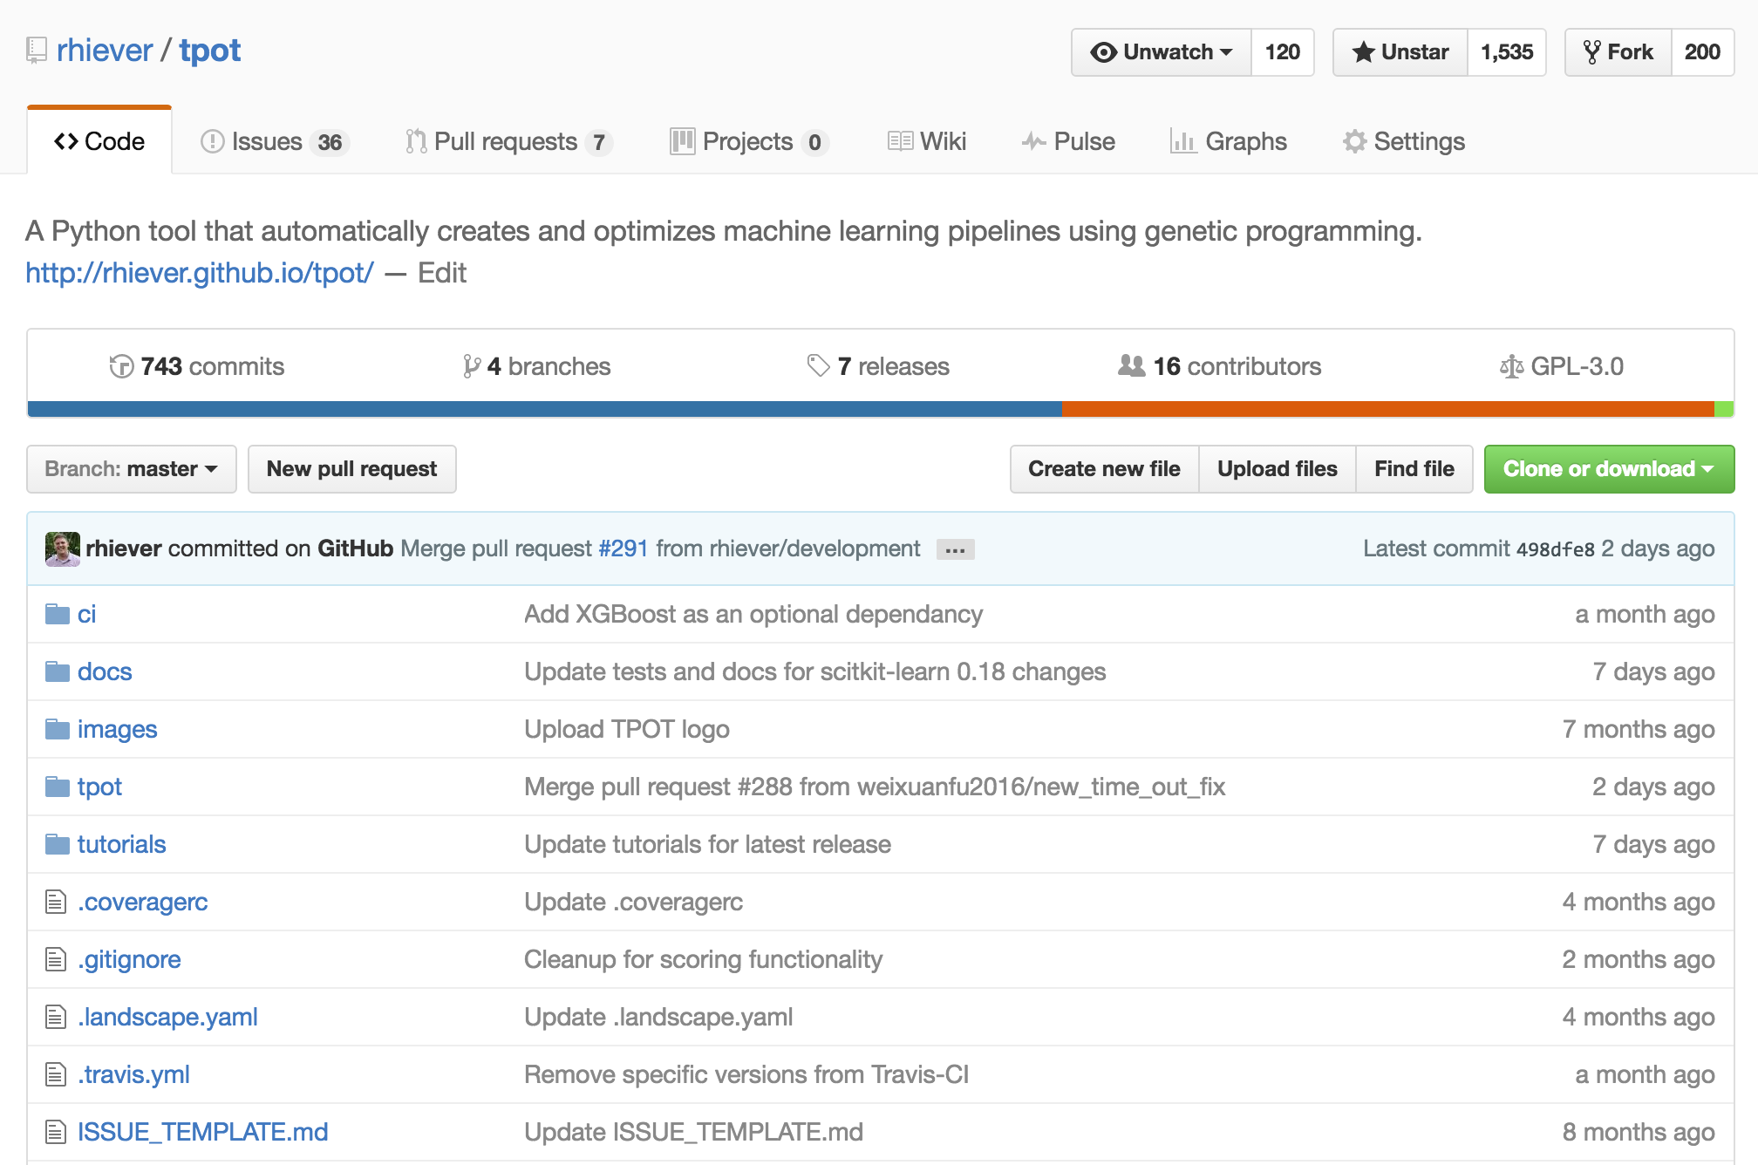
Open source tool for everyone

Slide 31
Demo

Slide 32
Conclusions
Yes We Can!
… automatically design useful ML pipelines
… without user input and domain knowledge
TPOT = Data Science Assistant
Still won’t replace data scientists
Time-saver and idea generator
Doesn’t replace models; wrapper for models

Slide 33
TPOT Limitations
Slow on large data
… but so are all other AutoML methods
“warm start” functionality being worked on
Search is still fairly ignorant
Integrating expert knowledge

Slide 34


Thank you
Inst. Bio. Info. @ UPenn
Daniel Angell
Weixuan Fu
Ryan Urbanowicz
Jason Moore
U. Chicago
Nathan Bartley
Michigan State U.
Sebastian Raschka
Independent
Harsh Nizar (India)

Slide 35

github.com/rhiever/tpot
olsonran@upenn.edu
@randal_olson
randalolson.com/publications
Notes:
If you want more data on how TPOT performs, send me an email and I’d be happy to send preprints of the research papers we have on TPOT.

